Slide 2
Oscied
Open source cloud infrastructure for encoding to disctribution

Slide 3
Oscied basics
Scalable cloud infrastructure
Virtualisation of services
Elasticity: Fast up-/down-scaling
Manageable services
Control scaling of virtual services
Manage setting of encoding to distribution
All components are open source
Library of code embedded in functional service
Fast interchange of knowledge
Availability of development communities
Modular development
Use of interchangeable modules
Decentralised parallel development
Remote accessibility of scalable development, test and production environment

Slide 4
Oscied development cycles
Basic code (current / first development cycle)
On demand video using X264 as video encoding format.
Current developments
A professional management layer for the system as a whole will be at the core of this system.
MPEG DASH, both for Live and VOD and play out to different devices (laptop, HbbTV, Tablet and Smartphone both for Android and iOS).
Optimisation of distribution by adding automated management of data flows
Automation of broadcast processes
Addition of interactive services

Slide 5
Cloud infrastructure for broadcasters
PRIVATE CLOUD
Management layer
Virtual machines for encoding
Virtual machines for Distribution
PUBLIC
CLOUD
Virtual machines for encoding
Virtual machines for distribution

Slide 6
Cloud infrastructure for broadcasters
Management layer in private cloud
Allow professional users to manipulate setting of the virtual encoders and distribution machines
Management of recourses in private and public cloud
Real-time monitoring of running processes
Virtual services in private cloud
Use of local machines that run virtual services
Scaling on permanent use in local loop
Encoding high resolution feeds
Virtual services in public cloud
Fast scaling infrastructure for peak offload
Optimisation of decentralised processes

Slide 7
OSCIED
Private cloud
PHP
Resource overview window
Manage
Assets
Encoding settings
Distri- settings
FFMPEG
APACHE
Clients
Files
MPEG-DASH
CDN
PUBLIC
CLOUD
Virtual machines for encoding
Virtual machines for distribution
Clients
CDN
Files
MPEG-DASH

Slide 8
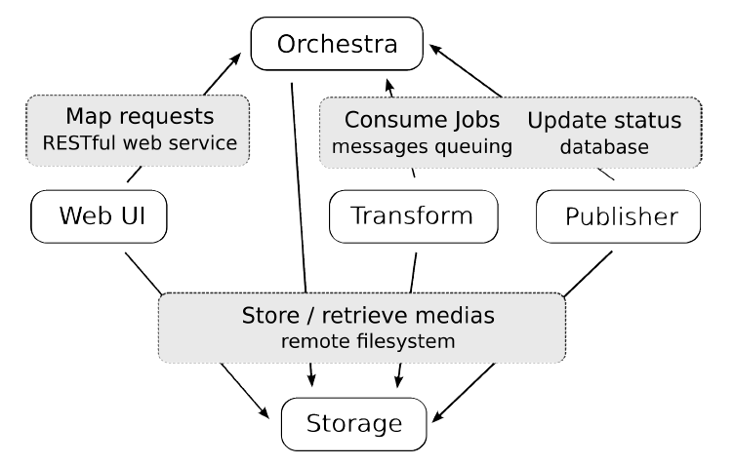
Current components of oscied

Slide 9
OSCIED basic code
PHP: Management layer in private cloud
Monitor window visualising running processes
Settings menu for encoding settings
Setting menu for distribution via private and public cloud Apache virtual machine
> Basic code supports minimal a manual upload of files, a manual input of metadata and proven playout via private cloud an Amazon cloud.
Cloud infrastructure
Virtual machines for encoding (FFMPEG)
Virtual machines for distribution (Apache)
Automatic scaling private to public cloud (JuJu) on basis of business rules
Install script for OSCIED on local hardware
> Basic code supports only Apache virtual machine (with CodeShop streaming module) in private an public cloud. NGIX vm, automated CDN output, streamlink interface with other backends are not available in this version.

Slide 10
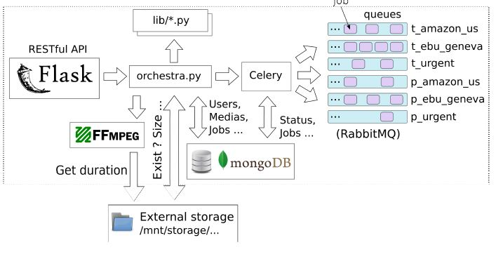
orchestrator

Slide 11
Orchestrator build
OSS Tools
• Flask Python Micro Web Framework
• PyMongo Python module for working with MongoDB
• MongoDB Scalable, High Performance NoSQL Database from 10gen
• RabbitMQ AMQP Message Broker from vmware
• Celery Distributed Task Queue
• JuJu Cloud Orchestrator from Canonical
Orchestrator manages all actions in OSCIED via:
• the RESTful API, to expose application’s functionalities to user
• the database, to store application’s data (users, profiles, jobs, ...)
• the message broker, to communicate with workers (transform & publisher)

Slide 12
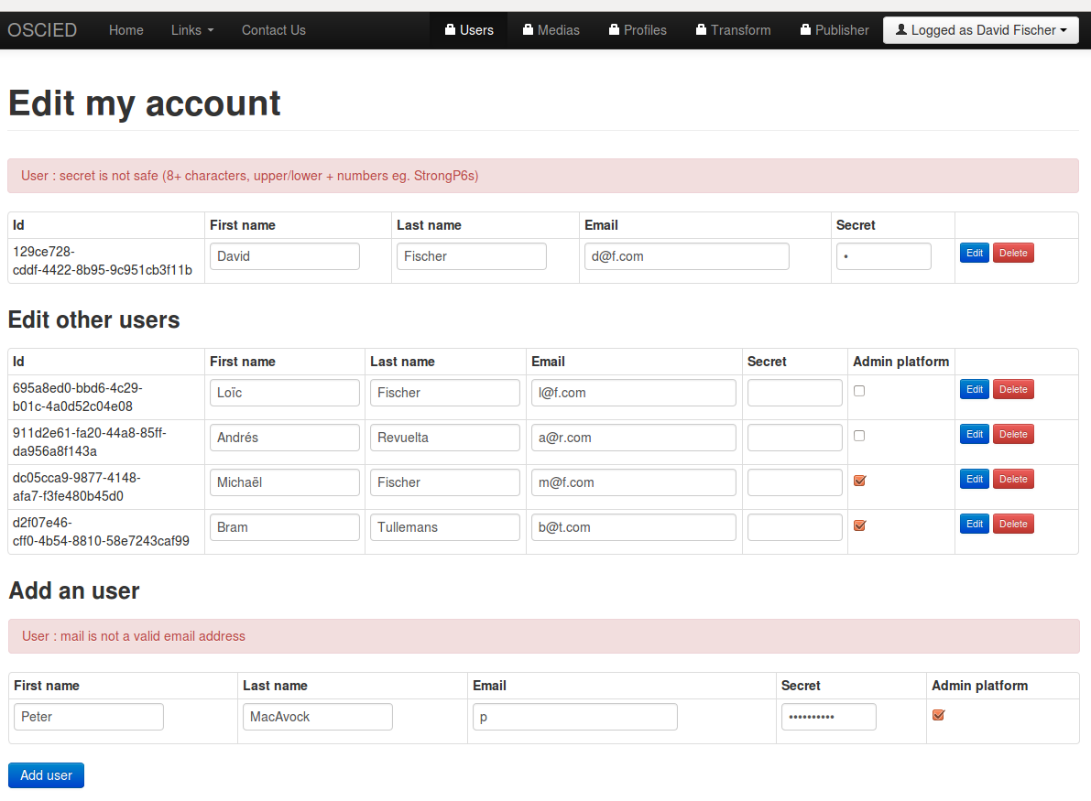
Account settings

Slide 13
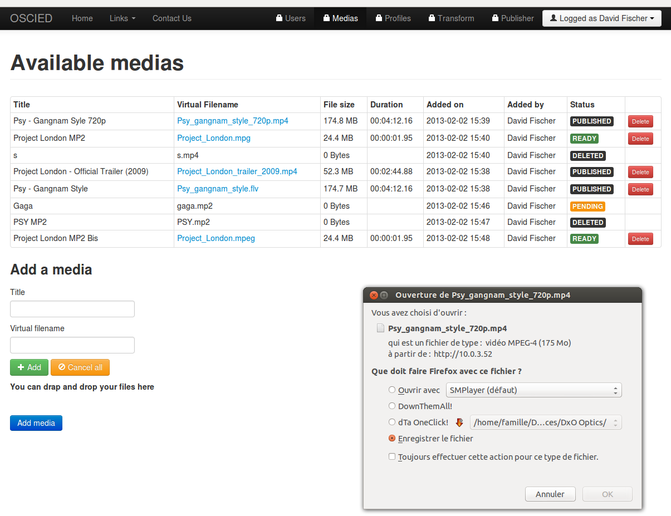
Imported media

Slide 14
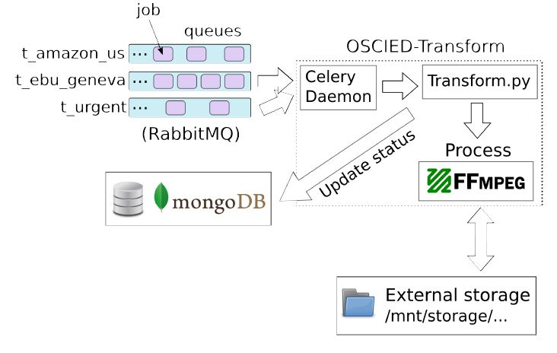
Transform unit

Slide 15
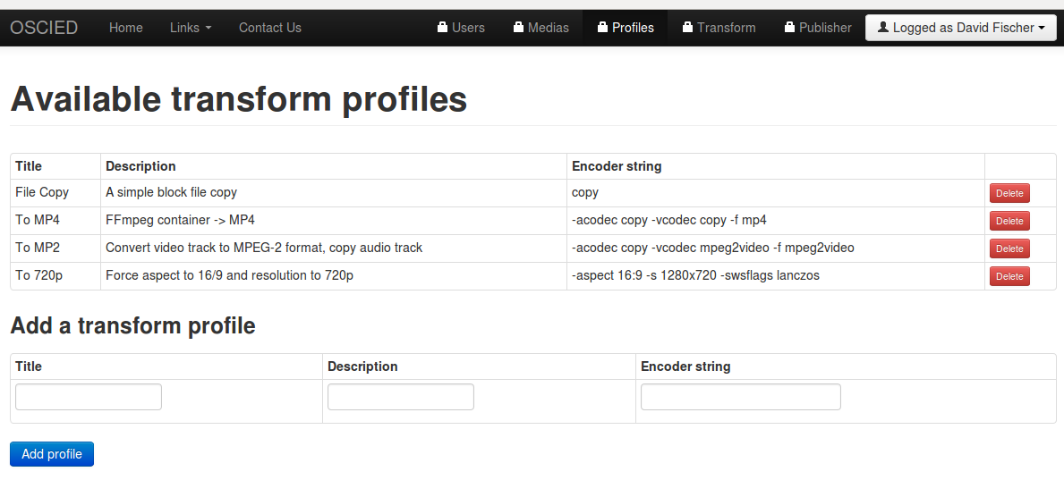
Encoding settings

Slide 16
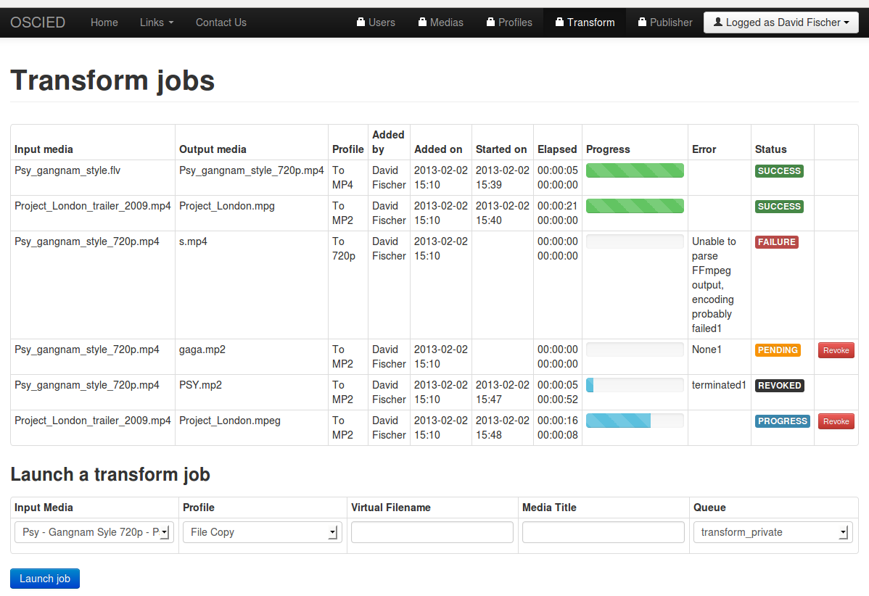
Encoding queue

Slide 17
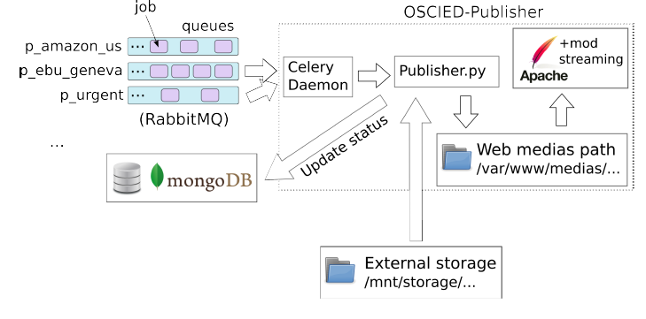
Distribution

Slide 18
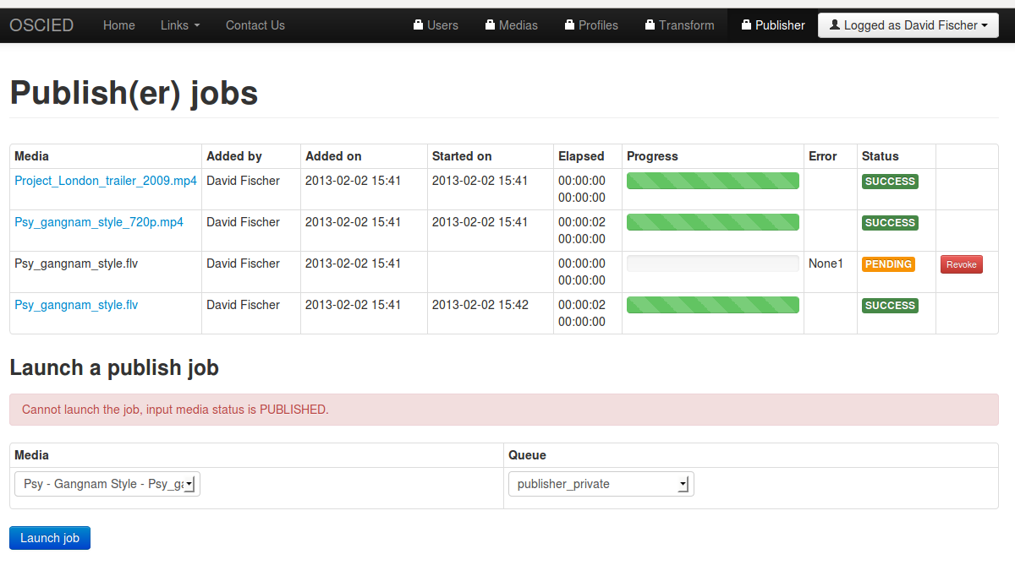
Distribution window

Slide 19
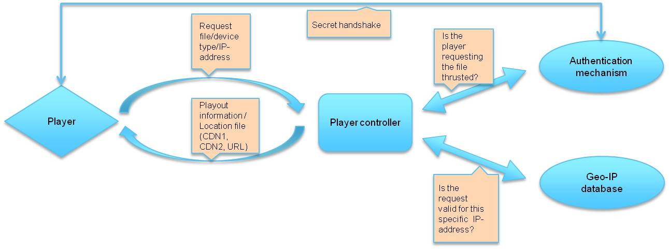
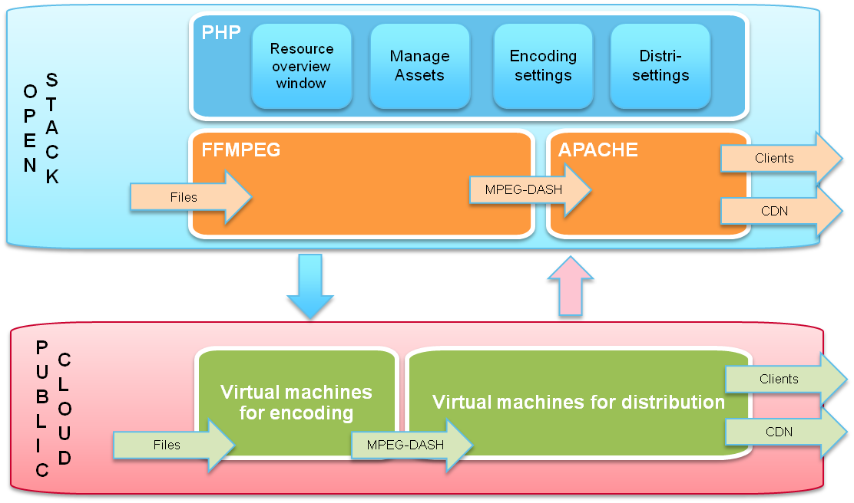
Media Asset management and Oscied*
Content Management System
4
3
Source (live feeds and MAM files)
1
2
Decentralised Content Management System
Decentralised Source (live feeds and files)
* Not available in basic version of OSCIED

Slide 20
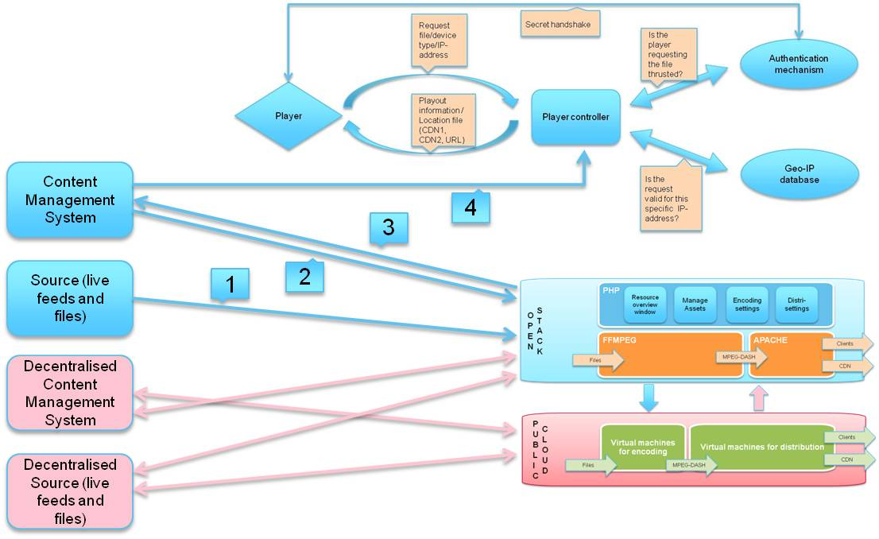
Media asset management and oscied
OSCIED needs to be able to interface automatically with MAM backends in order to become useful in a professional environment
A source file is uploaded to the private cloud of OSCIED
The CMS sends a notification XML with details of the file that is uploaded (name, location, requested encoding profile and publication details)
The management layer of OSCIED will send a notification XML to the CMS when the file is available where in the distribution chain
The CMS will communicate with the Player Controller the locations of the files
It should be possible to ingest content directly in the public cloud of OSCIED, or from a external location to the private cloud.

Slide 21
Potential mediaflows
Internet Exchange
Real time metadata
PRIVATE CLOUD
Management layer
Content over IP
Virtual machines for encoding
Virtual machines for Distribution
SDI Live feed
Video feeds over IP
PUBLIC
CLOUD
Virtual machines for management
Virtual machines for encoding
Virtual machines for distribution
CDN2
CDN1
Real time metadata
ISP3
(Mob ile network)
ISP2
ISP1
EU
EU
EU
EU
EU
EU
D
D
D
D
D
D
D
D
D
D
D
D
D
D
D
D
D
D
D
D
D
D
D
D
D
D
D

Slide 22
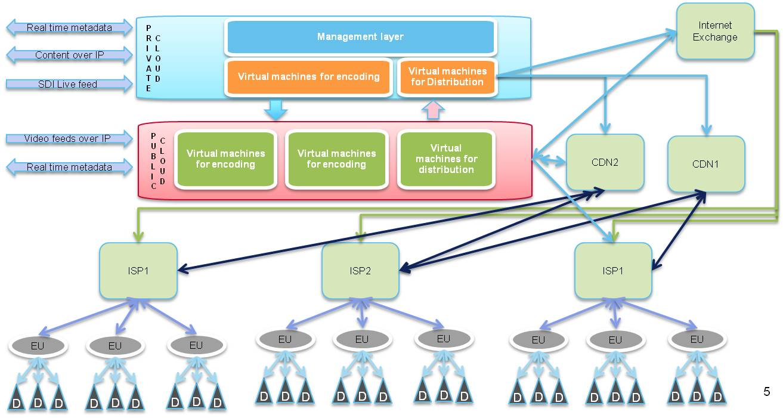
communication overlay
Connect different distribution outlets with automated distribution intelligence to optimise data flows from and to OSCIED
Distribution overlay: The management environment decides what the the optimal data route is to distribute content from private or public OSCIED via IXPs, CDNs, ISPs, End User networks (EU) to specific devices (D).
Congestion in network avoided
Capabitlity of network is taken into account (for example if it can transcode content for playback on specific devices)
Distribution costs are taken into account (cost per GB or GB/s)
Communication overlay: Dataflows from end user devices (D) are alligned with those of the content provider and processed in the cloud or the network (for example active nodes in the CDN)
Synchronisation of media flows
Generating interactive interfaces to thin clients / devices with limited playback options
Upload of source files of media assets that are processed dectralised (remote editing, postproduction, etc.)

Slide 23
Player backend communication
Request file/device type/IP-address
Secret handshake
Is the player requesting the file thrusted?
Authentication mechanism
Player
Player controller
Playout information / Location file (CDN1, CDN2, URL)
Which route
What distribution
route is most
efficient?
Geo-IP database
Buffer underrun / ping speeds / start latency / sustained video speed (bitrate playout)
Is the request
valid for this
specific IP-address?
QoE / distrabution measurement
Start / stop moments in files that are played out
Audience measurement

Slide 24
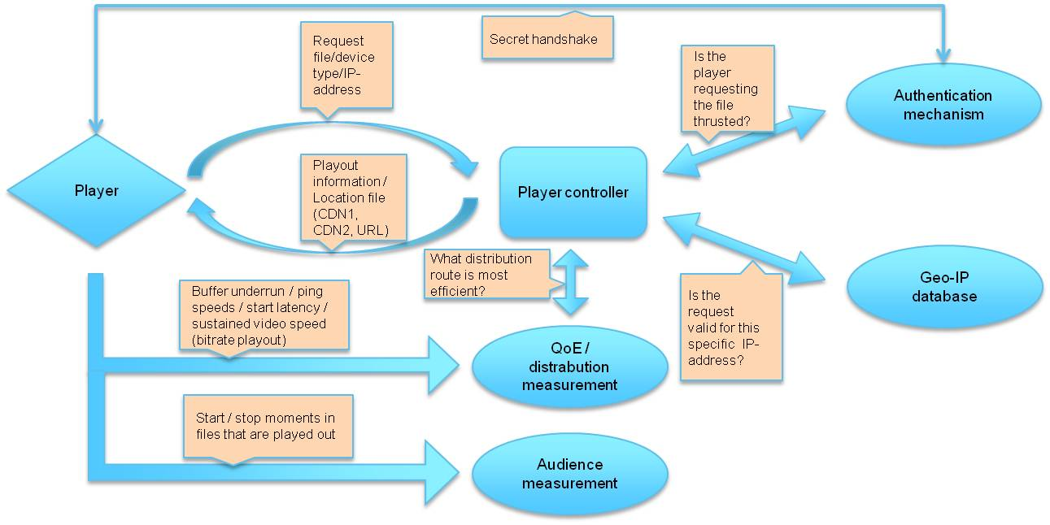
Future intelligence in oscied
Player backend functionalities and other feedback loops can be part of OSCIED in the future.
Player sends information to OSCIED that can be used for end to end monitoring of the IP-network. This information can be used to manage traffic flows, for example avoid a busy CDN at a certain moment.
Player sends information to OSCIED that can be used for audience measurement.
Player can request a media file for playback from OSCIED. The Player Controller of OCSIED checks:
If the player is authentic
If the player is used in an accepted location
What the best available location of the file is
Player receives an XML or MPD with information about either:
The location of a still informing that the file cannot be played out in that region
The location of the media files that can be played out from the easiest to reach cache

